Slide 1
Project 1:
America’s Housing Market
UNC Data Analytics Bootcamp
May 2, 2023
Group 3: Lora Loutsis, Austin Lawrence, Juhi Chinthapatla, Kesha Patel, and Himabindu Pati
Notes:
Kesha

Slide 2
Questions
Is there a correlation between house price and mortgage rate?
Methods: create a scatter plot, calculate the r value, develop a linear regression line
Kaggle Dataset: House price vs. mortgage rate
How are the following macroeconomic factors (i.e., unemployment rate, real disposable income, House Price Index (HPI), mortgage rate, inflation, Consumer Price Index (CPI), GDP) associated with each other?
Method: Plot on a line graph the following macroeconomic factors and look at the graphs and make conclusion
Kaggle Dataset: Market factors
What do our comparisons tell us, and how are they related to household income?
Method: Track the percent increase for household income and compare it to the percent increase of other relevant macroeconomic factors
Kaggle Dataset: Market factors
Median Household Income Data: US Census Bureau
Notes:
Kesha

Slide 3
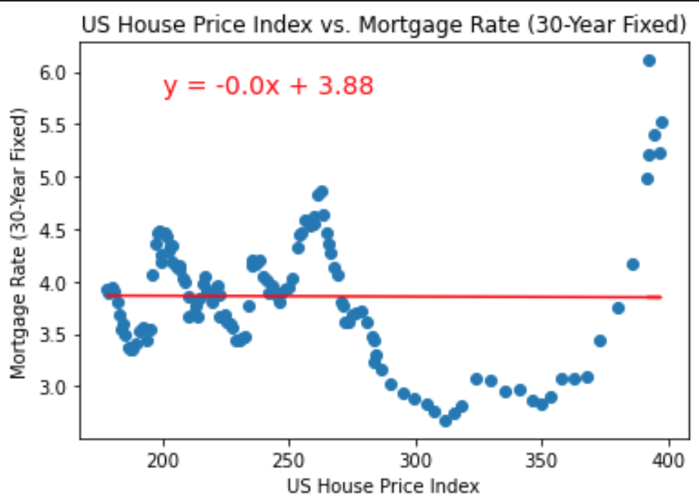
US House Price Index (HPI) & Mortgage Rate (30-Year Fixed)
The r-squared value is -0.007304294665406224, which is indicative of no linear correlation between the x- and y- variables.
Notes:
Juhi: To start off the discussion, we first looked into if there is a correlation between the US House price index and mortgage rate for a 30-Year fixed loan. Mortgage rate is basically the interest rate you have to pay a bank or lender when you borrow money to buy a home, while the US House Price Index is an index to displaying how single family home prices have fluctuated over the years. So, using python, I created a scatter plot and a linear regression line based on data from Kaggle. After looking at the scatter plot along with the r^2 value being so close to 0, it is clear that there is no linear correlation between the US House Price Index and Mortgage Rate.
Kaggle Dataset, US House Price and Mortgage Rate: https://www.kaggle.com/datasets/tiffanytong0321/housepriceandmortgage?resource=download

Slide 4
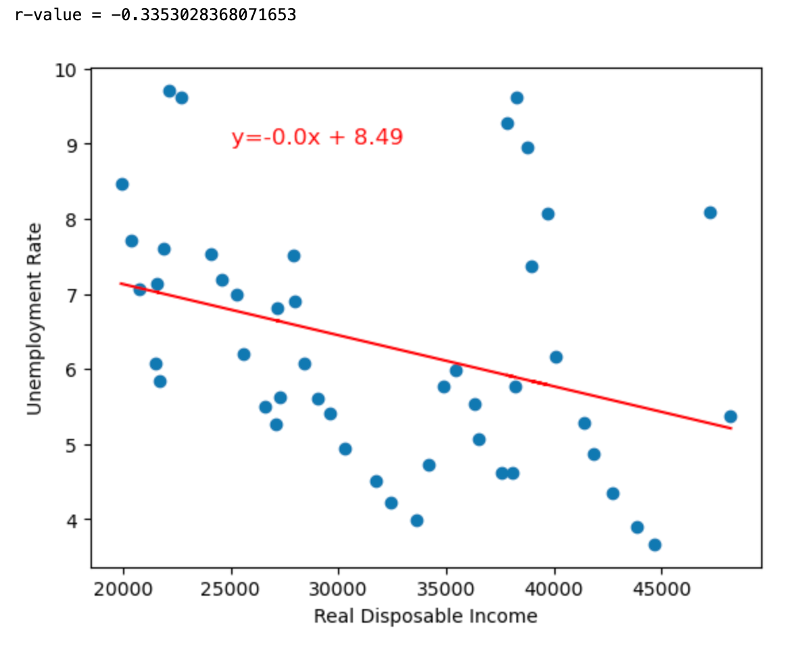
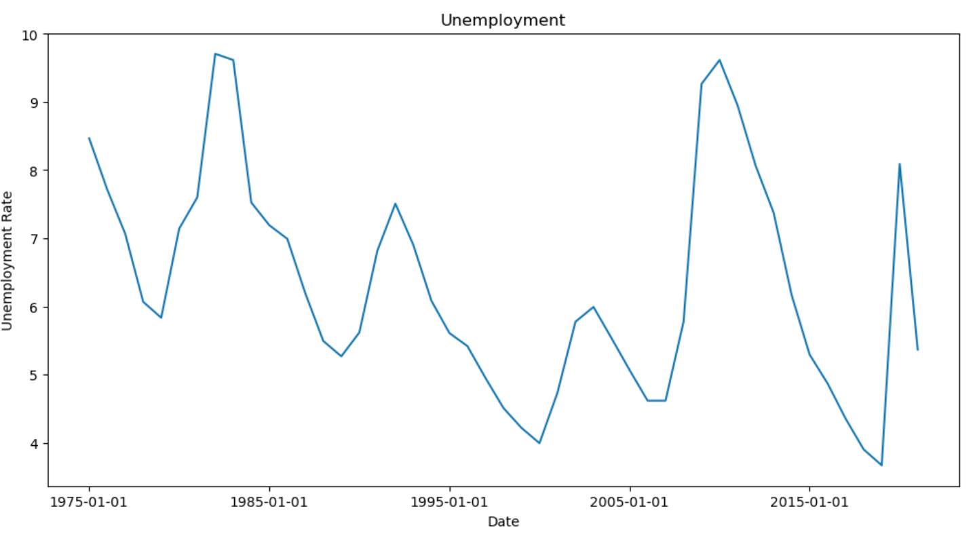
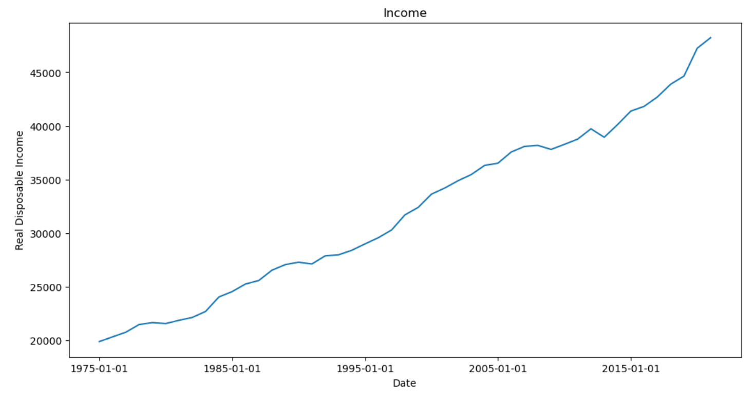
Real Disposable Income & Unemployment Rate
Figure 2. Line plot of unemployment over time.
Figure 3. Line plot of real disposable income over time.
Figure 1. Scatter plot of unemployment rate and real disposable income. The r-value is -0.34 showing low negative correlation.
Notes:
Lora:
-Figure 1 is a scatterplot that evaluates the relationship between the macroeconomic factors
unemployment rate and real disposable income
-The data set included yearly data from 1975 to 2021
-Results show low negative correlation
-Figures 2 and 3 show these macroeconomic factors individually
line graphs of unemployment over time and income over time
While income steadily increases, the unemployment rate is variable over time
-Conclusion: a r-value of -0.34 shows a low negative correlation. When income is low, unemployment is high. When income is high, unemployment is low. The correlation is weaker than hypothesized which may be due to other macroeconomic factors. Further exploration into other macroeconomic factors is recommended for future research.

Slide 5
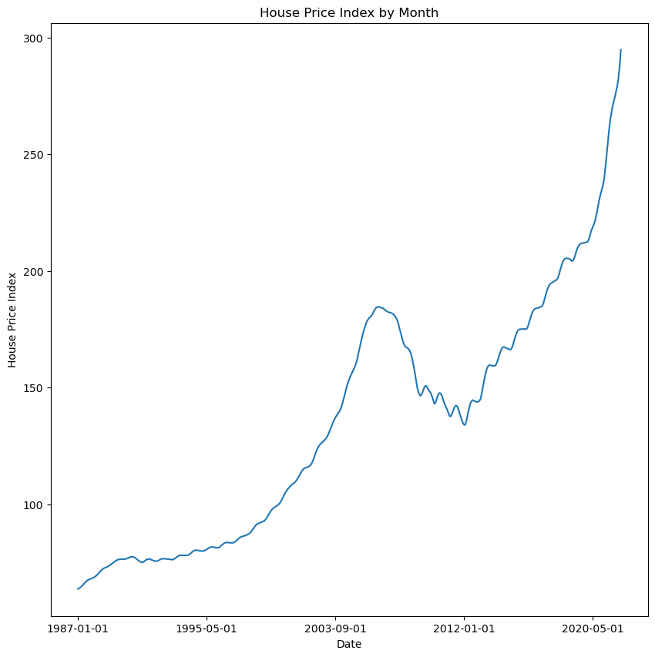
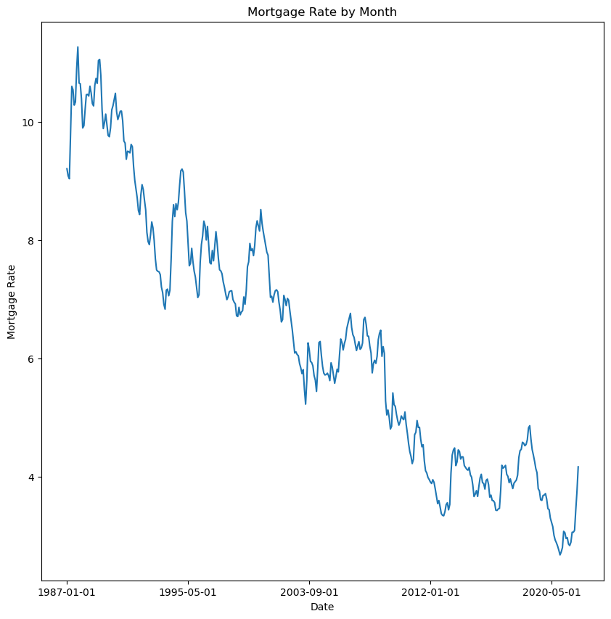
HPI & Mortgage Rate (Monthly)
Figure 1: The line graph shows House Price Index (HPI) per month. As time increases, the HPI increases except in the mid period of taken time.
Figure 2: The line graph shows mortgage rate by month. As time increases, the mortgage rate decreases.
Notes:
Hima
Fig1: The line graph shows House Price Index per Month, as time increases the House price increased except in the mid period of taken time.
Fig2: The line graph shows Mortgage Rate by Month, as time increased the Mortgage rate decreased.
Fig3: The line graph shows House Price Index by year, the house price index increased over time, there is a fall for some period.
Fig4: The line graph shows decrease in Mortgage Rate by year.

Slide 6
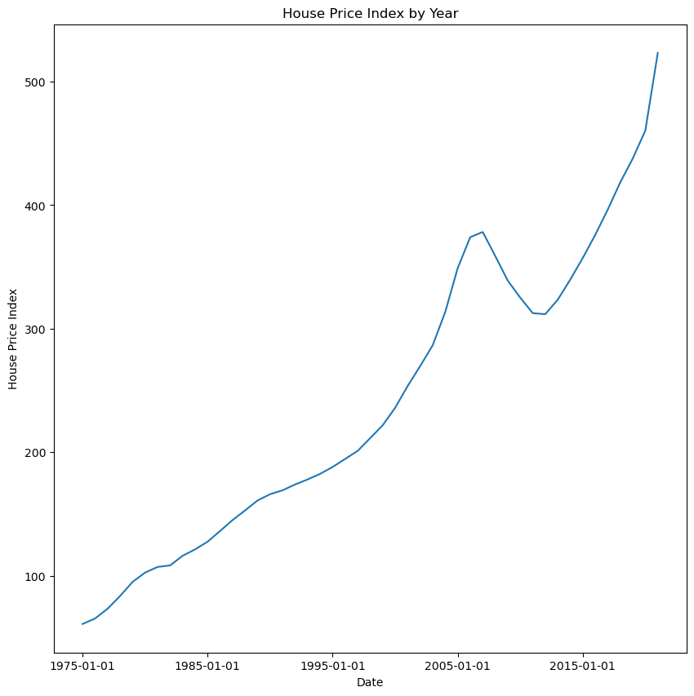
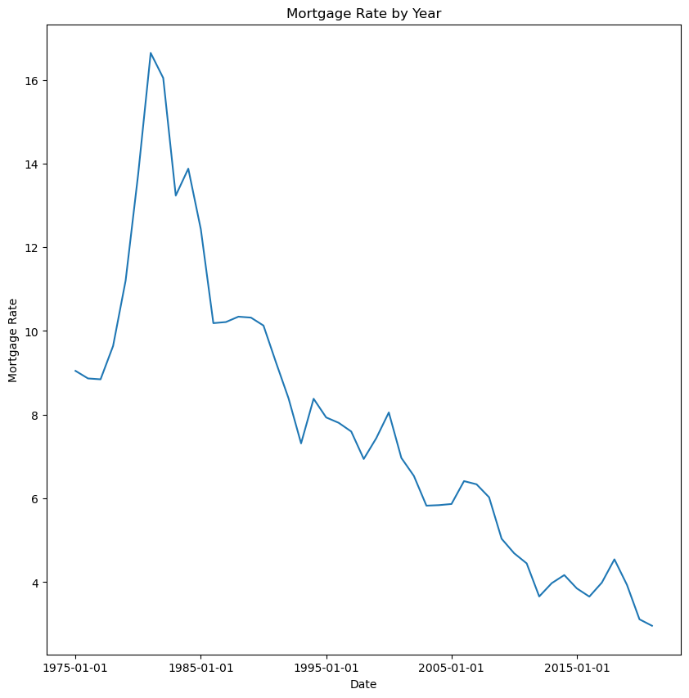
HPI & Mortgage Rate (Annually)
Figure 3: The line graph shows HPI by year. Overall, the HPI increases over time, but there is a slight decrease in HPI for a small period in time.
Figure 4: The line graph shows decrease in mortgage rate by year.
Notes:
Hima
Fig1: The line graph shows House Price Index per Month, as time increases the House price increased except in the mid period of taken time.
Fig2: The line graph shows Mortgage Rate by Month, as time increased the Mortgage rate decreased.
Fig3: The line graph shows House Price Index by year, the house price index increased over time, there is a fall for some period.
Fig4: The line graph shows decrease in Mortgage Rate by year.

Slide 7
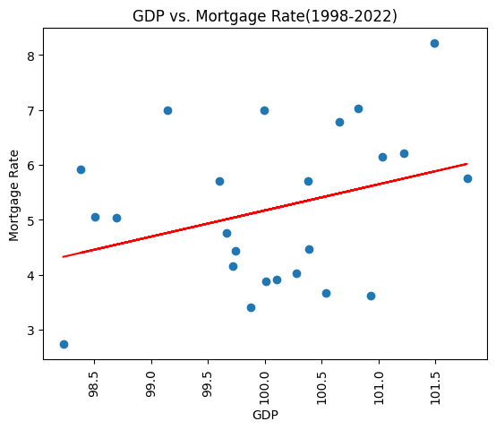
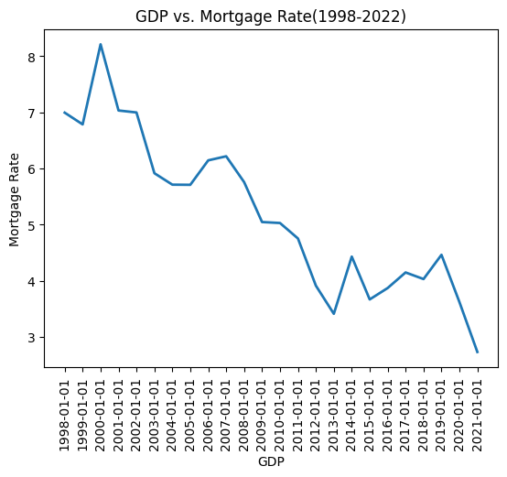
GDP & Mortgage Rate (Annual)
Correlation = 0.32
Notes:
Kesha

Slide 8
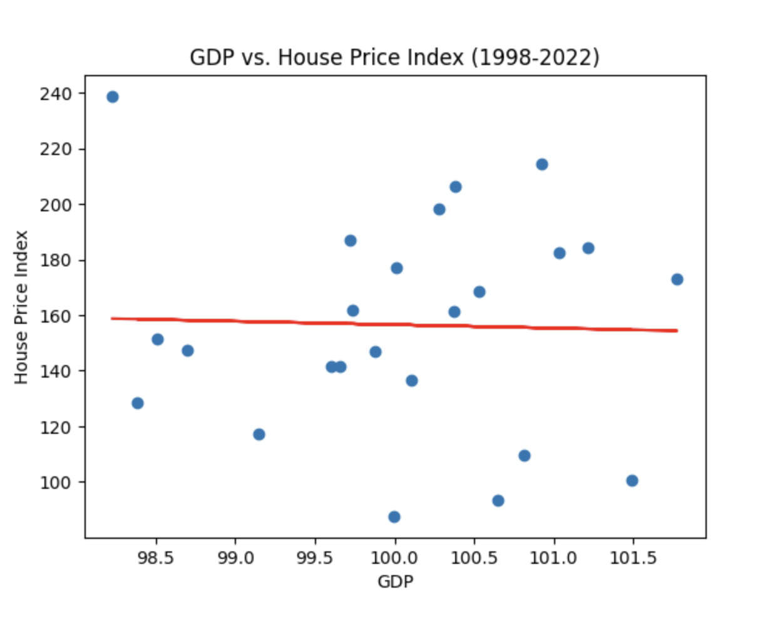
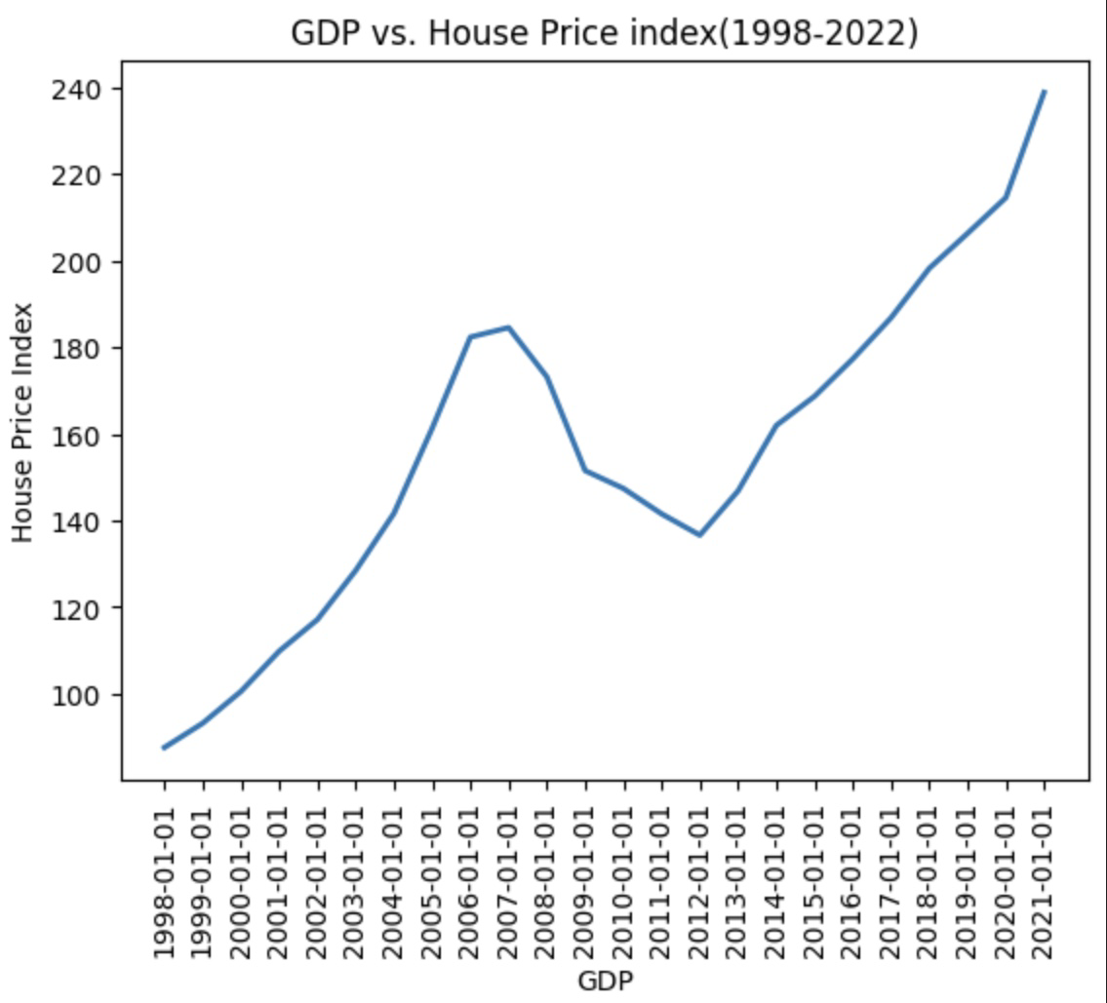
GDP & HPI (Annual)
Correlation = -0.03

Slide 9
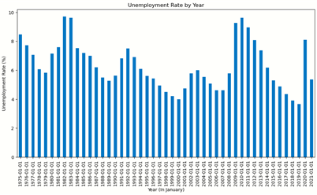
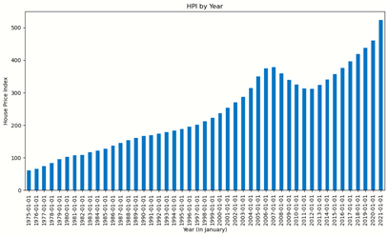
Unemployment Rate & HPI
Figure 1: Bar graph illustrating Unemployment Rate between Jan. 1975 and Jan. 2021
Figure 2: Bar graph illustrating House Price Index between Jan. 1975 and Jan. 2021
Notes:
Austin
The rate of unemployment does not seem to really have much to do with the HPI
There is an ebb and flow of high and low unemployment rates while HPI has increased steadily
The hill that is visible in the HPI bar chart can be attributed to the housing crisis in the late 2000’s

Slide 10
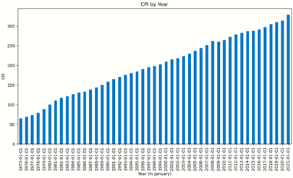
CPI & HPI
Figure 1: Bar graph illustrating Consumer Price Index between Jan. 1975 and Jan. 2021
Figure 2: Bar graph illustrating House Price index between Jan. 1975 and Jan. 2021
Notes:
Austin
CPI is essentially a measure of the cost of goods currently relative to a base cost, similar to HPI but for consumer goods
Both CPI and HPI have both risen at fairly steady rates over the years

Slide 11
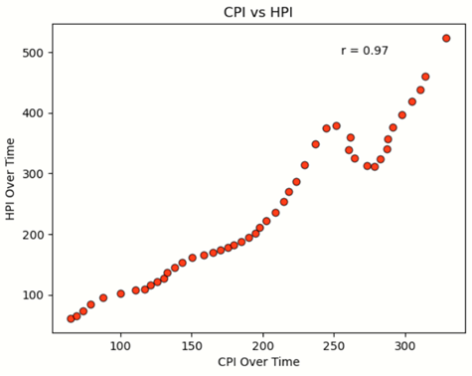
CPI & HPI
Figure 1: Scatter plot comparing CPI increase to HPI increase between Jan. 1975 and Jan. 2021
Notes:
Austin
CPI and HPI have a strong correlation to each other, and have both increased steadily over the years
This makes sense, we would expect both to evenly increase over time
However, as the next slide shows, there is an asterisk with this data

Slide 12
Household Income vs Changes in CPI/HPI
Median Household Income
January 1975: $13,720 ($68,885 in January 2021 adjusted for inflation)
January 2021: $70,784
Without accounting for inflation: 415.92% increase
2.76% increase
Consumer Price Index (CPI)
January 1975: 65.3
January 2021: 328.8
403.51% increase
House Price Index (HPI)
January 1975: 61.09
January 2021: 523.26
756.54% increase
Notes:
Austin
We have been able to track a lot of trends, but how does it all relate to the current problem of housing affordability?
As you can see, the CPI and HPI have both increased a great deal, HPI the most
Median Household Income on the other hand, has increased minimally
Outside of the unemployment rate, which tends to fluctuate, every other economic factor that relates to purchasing a home has increased
As Lora’s data shows, real disposable income has increased, but that data does not account for purchasing power or adjust for inflation
It is clear to see that the increase in the HPI is exponentially larger than that of the Household income
This is why it is harder to buy a home now than it used to be, while disposable income has gone up at a steady rate, purchasing power has actually declined

Slide 13
References
Kaggle Dataset, US House Price and Mortgage Rate (Jan 2012 - Sep 2022): https://www.kaggle.com/datasets/tiffanytong0321/housepriceandmortgage?resource=download
Kaggle Dataset, US Housing Market Factors: https://www.kaggle.com/datasets/faryarmemon/usa-housing-market-factors
US Census Bureau, 2021 Median Household Income: https://www.census.gov/library/publications/2022/demo/p60-276.html
US Census Bureau, 1975 Median Household Income: https://www.census.gov/library/publications/1977/demo/p60-105.html#:~:text=As%20indicated%20in%20the%20advance,over%20the%20revised%201974%20median

